Slide 1

SDNPA LOCAL PLAN REVIEW
PUBLIC MEETING
Easebourne Primary School
7pm-8.30pm Thursday 4 June 2026

Slide 2
Purpose of this Meeting
On 12 May 2026 the SDNPA published its latest version of its proposed Local Plan - this time for its second (Regulation 19) consultation. The purpose of this meeting is to provide information on the proposed SDNPA Local Plan and gather feedback from you that will influence the Parish Council response.
Cautionary Note: Easebourne Parish Council is not a “statutory consultee” … our comments carry the same weight as any private individual; however, we will do our best to capture your views and present them to SDNPA.

Slide 3
What we are going to cover
Introduction
Why are we here? … what is a Local Plan and why is important What is a Local Plan. What is contained within a Local Plan - specifically the proposed SDNPA Local Plan. What are the timelines for the proposed SDNPA Local Plan. How – and where - is Easebourne affected by this local plan What has been commented on so far.
Comments from local residents groups: Upperfield Residents Association Residents Action Group (RAG)
How to submit your comments to SDNPA Actions for you Have your say
Wrap up & Close

Slide 4
What is a Local Plan
Local plans are a medium-term planning document – renewed every 5 years and used by Local Planning Authorities (LPA) to establish and document the vision and plans for each area.
National planning policy says that the planning system should be genuinely plan-led, and that succinct and up-to-date plans should provide:
  a positive vision for the future of each area;
  a framework for meeting housing needs and addressing other economic, social and environmental priorities; and
  a platform for local people to shape their surroundings.
Why does this matter? because once the Local Plan is agreed the LPA will usually follow it - so if you disagree with it NOW is the time to say.
This is NOT the same situation as we were in when detailed plans were submitted for the most recent 3 sites in the village.

Slide 5
What is contained within the proposed SDNPA Local Plan
Introduction and Context | Explaining what the Local Plan aims to do, how it fits in with National and Regional and relevant local information (e.g. local population, demographics and expected growth).
Vision & Objectives | This section lays out SDNPA’s Vision and objectives … which have recently been refreshed & renewed in SDNPA’s Partnership Management Plan (2026-31).
Spatial Portrait & Strategy | This section lays out some of the things that make the SDNP special; our key challenges and the strategy … which is broadly to develop where infrastructure (particularly transport is strongest). Easebourne is classified as “amber – some potential”
STRATEGIC POLICIES (Pages 20-137) | SDNPA has listed 58 Strategic Policies, covering various elements relevant to planning:
 | LANDSCAPE & HERITAGE NATURE & CLIMATE WATER & POLLUTION | HOUSING ECONOMY COMMUNITY SPACES | TRANSPORT & INFRASTRUCTURE
SITE ALLOCATIONS (Pages 138-293) | Details the plans & the proposed sites for each “Primary Settlement” … there are 77 proposed Sites across the National Park

Slide 6
What are the timelines for the proposed SDNPA Local Plan
2022 | Preparation of the new proposed Local Plan began
2023 | Early engagement with Town and Parish Councils – encouraging Parish Priorities Statements … Easebourne Parish Council produced a “Village Design Statement”
2024 | SDNPA produced various supporting reports
2025 | Jan- Mar: First (Regulation 18) Consultation. Over 3,700 comment received. EPC and many residents submitted comments
2026 | May-Jun: Second (Regulation 19) Consultation. SDNPA submits its proposed Local Plan (plus comments) to the Secretary of State for independent examination.
2027 | New Local Plan expected to be adopted.

Slide 7
How – and where - is Easebourne affected by this local plan
Settlement | Easebourne is now being considered in with Midhurst. While this may seem sensible on some levels, as Easebourne is much smaller and distinct from Midhurst (politically, geographically and in character) EPC has already objected to SDNPA on this.
Representation | Easbourne is described as having a population of 1,170 people all living in the old village. However, Easebourne Civil Parish (and Electoral Ward) has over 2,000 people – a third of whom live on the King Edward VII Estate. The SDNPA makes no reference to the King Edward VII estate, neither to the major development still going on there nor the c.800 residents. EPC believed this is disingenuous and has objected to SDNPA on this.
Sites | All three sites originally identified remain on the list with only minor adjustments.

Slide 8
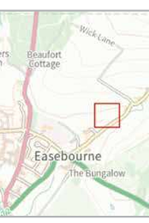
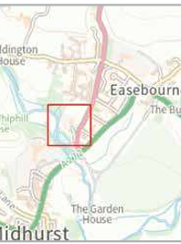
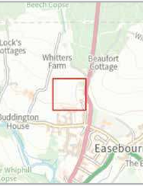
The three sites
CH203 - Land adjacent to former Easebourne School | CH147 - Midhurst Community Hospital and 1-2 Rotherfield Mews | CH206 - Land west of Budgenor Lodge

Slide 9
What has been commented on so far
In response to the Reg 18. Consultation (March 2025) … | EPC “strongly objected” to all three sites: CH147 Midhurst Community Hospital and 1-2 Rotherfield Mews CH203 Land adjacent to former Easebourne School CH206 Land west of Budgenor Lodge The basis for these objections being: Disproportionate scale of development and impact on housing density Development within a National Park Heritage and Character … including proximity to listed buildings Protection of Farmland & Greenfield Areas Protection of Biodiversity and Habitats Impact on Traffic and Pollution Local Infrastructure Schools Healthcare Utilities Design and Sustainability Types of Housing Public Transport
SDNPA initially misrepresented EPC’s comments but this was corrected in July 2026.

Slide 10
Presentations from local residents’ groups
Upperfield Residents Group
  Peter Moss
Residents Action Group (RAG)
  Nicole Reid

Slide 11
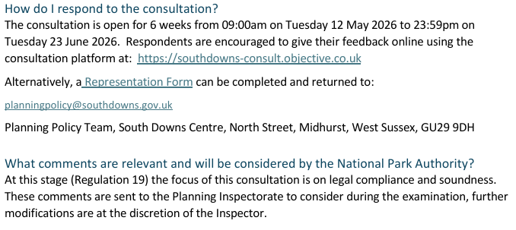
How to submit your own comments to SDNPA
DEMO
Emma Tremaine

Slide 12
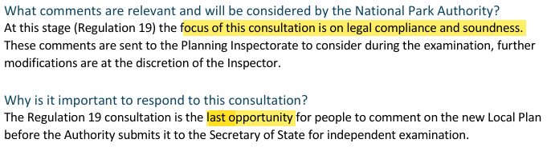
What can you comment on?
The SDNPA guidance says:

Slide 13
Actions for you
Submit your comments to us and SDNPA
  Submit via the SDNPA online Planning portal
  Email planningpolicy@southdowns.gov.uk
  Copy your email to Parishclerk@easebourne.org
  Write to the Planning Department, SDNPA, North Street
Spread the word – make sure your neighbours know about the plans and have their chance to object
The deadline for comment is 23.59 on 23rd June 2026

Slide 14
Have your say
There are stations around the room for you to:
Talk to EPC Councillors
Ask questions
Look at SDNPA Local Plan materials; and
Add your comments and thoughts.

